Slide 1
Exploratory Model
Ankur
Rajat
Swapnil
Ashish
Alan

Slide 2
Introduction
Informal development style
Programmer uses his own intuition to develop a program.
This style of development gives complete freedom to programmer to choose activities which they like to develop software.
No rules to start developing any software

Slide 3
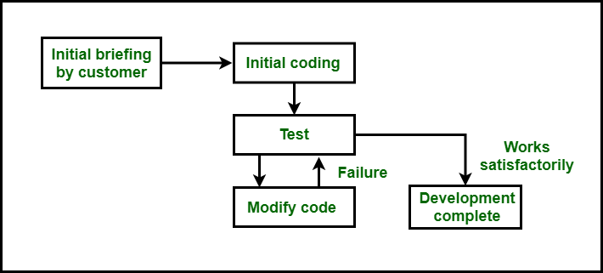
How Exploratory Model Works?

Slide 4
Advantages
Less Preparation Required
Real-Time Learning
Critical Bug Discovery

Slide 5
Disadvantages
Exponential growth of development time and effort with problem size and large-sized software becomes almost impossible
This style of development results in unmaintainable code
It is difficult to use this style when there is a proper developing team because in this style every developer uses his own intuition to develop software.

Slide 6
Project for using Exploratory Model :
Where Customer and developers both are not clear with the requirements of the product .
Small size software development
Develop Fast prototype
Most of the Space research programs uses exploratory research models at their research phases.
The era for exploratory models have now been limited to research and development only.

Slide 7

Any Questions

Slide 8

Thank You

